Slide 1
Samba Server

Slide 2
What is Samba Server
Samba is an Open Source Suite, that provides seamless file and print Service to SMB/CIFS client.
Samba is freely available.
With samba, you can share a unix file system with Wiindows and vice versa.
You can also share printers connected to either Unix or a System with Windows.
SMB stands for Server Message Block
CIFS stand for Common Internet file System is a protocol that is basically an updated SMB

Slide 3
Imp Samba Command
Testparm :- This utility is used to test the smb configuration file
Smbstatus :- This programs list the current Samba connection
SWAT :- Swat allow a Samba administrator to configure the smb configuration file via a Web browser.
Smbpasswd :- This allows the user to change the Password used for thair SMB sessions.

Slide 4
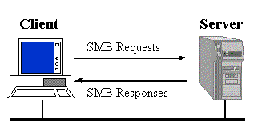
How Samba Works

Slide 5
Anonymous samba sharing
# apt-get install samba samba-common python-glade2 system-config-samba
# mkdir -p /samba/anonymous
# vim /etc/samba/smb.cnf
[Anonymous]
path = /samba/anonymous
browsable =yes
writable = yes
guest ok = yes
read only = no
# service smbd restart

Slide 6
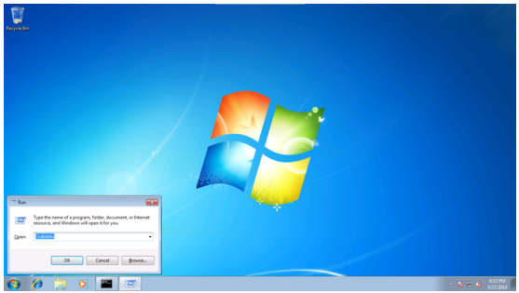
Now you can access the ubuntu sharing in windows as follows:

Slide 7
Secured samba server
For this I will create a group smbgrp & user srijan to access the samba server with proper authentication
# addgroup smbgrp
# adduser srijan -G smbgrp
# smbpasswd -a srijan
Now create the folder viz secured in the /samba folder & give permissions like this
# mkdir -p /samba/secured
# cd /samba
# chmod -R 0770 secured/

Slide 8
Again edit the configuration file as :
# vim /etc/samba/smb.conf
[secured] path = /samba/secured
valid users = @smbgrp
guest ok = no
writable = yes
browsable = yes
# service smbd restart
Now at windows machine check the folder now with the proper credentials

Slide 9
